Slide 1
Deep Learning Lecture 3 – INTRODUCTION to Computer Vision

Slide 2
OVERVIEW of Today
Schedule:
AT1A Feedback
History of CNNs
CNN Architecture
Famous CNN Architectures
Computer Vision Tasks
Lab:
Introduction to CNNs in Keras and Tf

Slide 3
OVERVIEW of Today
Schedule:
AT1A Feedback
History of CNNs
CNN Architecture
Famous CNN Architectures
Computer Vision Tasks
Lab:
Introduction to CNNs in Keras and Tf

Slide 4
AT1A Feedback
The good, the bad and the ugly
The story of this assignment
Generally done exceptionally well
Particularly impressive experimental work generally
Reach out early for help
Compiled answer notebook from the class available.

Slide 5

Some history of Computer Vision
(Video)
Let’s start in the late 1980’s
Hinton was working on back-prop algorithm (Source, 1986)
‘learning representations by back-propagating errors’
Some 17,145 citations…
Yann LeCun independently as well (Source, 1989)
‘backpropagation applied to handwritten zip code recognition’ (‘Pre-Lenet 1’)
Some 4,500 citations

Slide 6
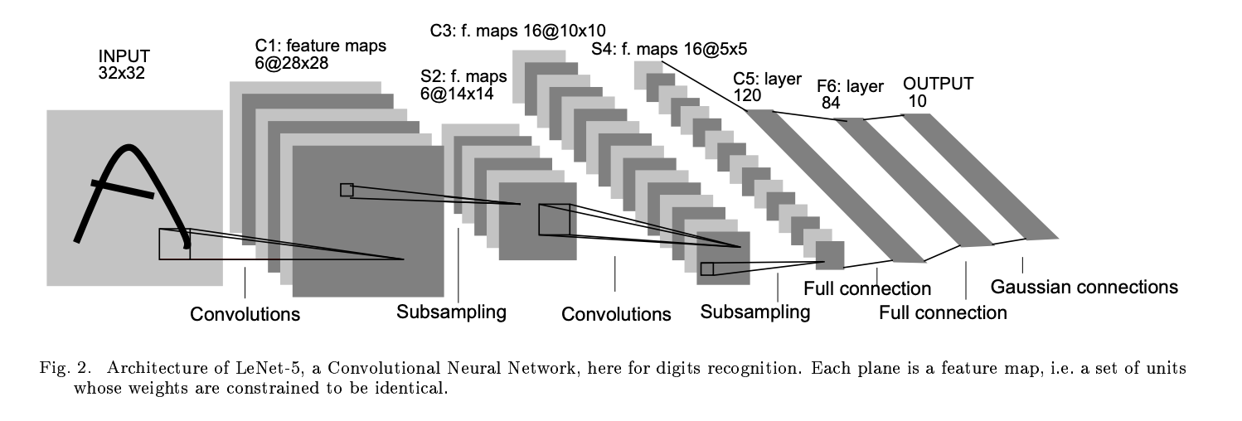
Some history of Computer Vision
Then improvements, released LeNet. Various versions. LeNet-5. (LeNet-5)
‘Gradient-based learning applied to document recognition’ (Source, 1998)
Some 17,895 citations…
Same Bengio as in Bengio & Bergstra (2012) random search paper

Slide 7
Then nothing…..

Slide 8
Then ImageNet
In 2009, Fei-Fei Li and others began working on putting together imagenet using mechanical turk.
1,00 categories. 14M images.
Competition (ILSVRC) run in 2010 first (Stopped in 2017)
Huge drop in 2012 with AlexNet, presented at NIPS 2012 (Source)
38,561 citations
Notes:
Interesting to look at the history of ILSVRC. VGG was Oxford, There is GoogleNet, Microsoft won in 2015

Slide 9
A note on ILSVRC
Year | Winner | People | Company/Uni
2012 | AlexNet | Alex Krizhevsky Ilya Sutskever Geoffrey Hinton | University of Toronto
2013 | Clarifai | Mathew Zeiler (founder) | Clarifai
2014 | VGGNet | Karen Simonyan Andrew Zisserman | Oxford University
2014 | GoogleNet | Christian Szegedy et al. | Google
2015 | ResNet | Kaiming He Xiangyu Zhang Shaoqing Ren Jian Sun | Microsoft
Notes:
Simonyan and Zisserman were brought over to DeepMind after their company Vision Factory was acquired by DeepMind in 2014. https://europe.googleblog.com/2014/10/teaming-up-with-oxford-university-on.html

Slide 10
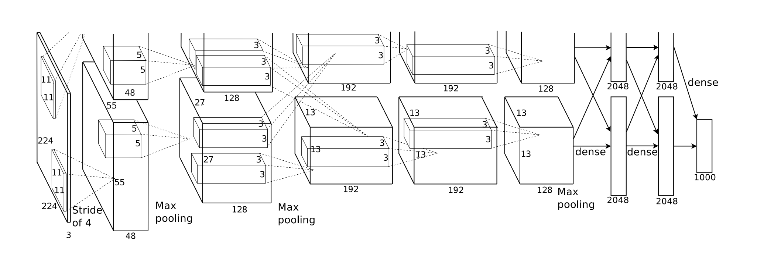
What is a CNN?
A CNN is constructed of a number of different layer types we have not seen before:
Convolution layers
Activations - We know this ☺
Pooling Layers
Fully Connected layers

Slide 11
You will understand this ☺
Notes:
GoogLeNet

Slide 12
Some Background
There is a large ‘semantic gap’ (link) between an image as a computer sees it and the way a human sees it.

Slide 13
Additional Difficulties
Occlusion (Part of the object is visible)
Illumination
Class variation (‘What is a cat’)
Background, other objects in the image

Slide 14

Convolution
We want to preserve spatial structure so employ a clever trick of matrix multiplication to build ‘Feature (Activation) Maps’ of our image.
We define a Filter/Kernel that undertakes multiplications, slides across, continues.
Each multiplication makes 1 number on our ‘Activation Map’
However, we do this in 3-dimensions rather than just a single dimension.
This is called a Tensor Contraction
The filter/Kernel must have the same depth as the input

Slide 15

Convolution in 3D

Slide 16
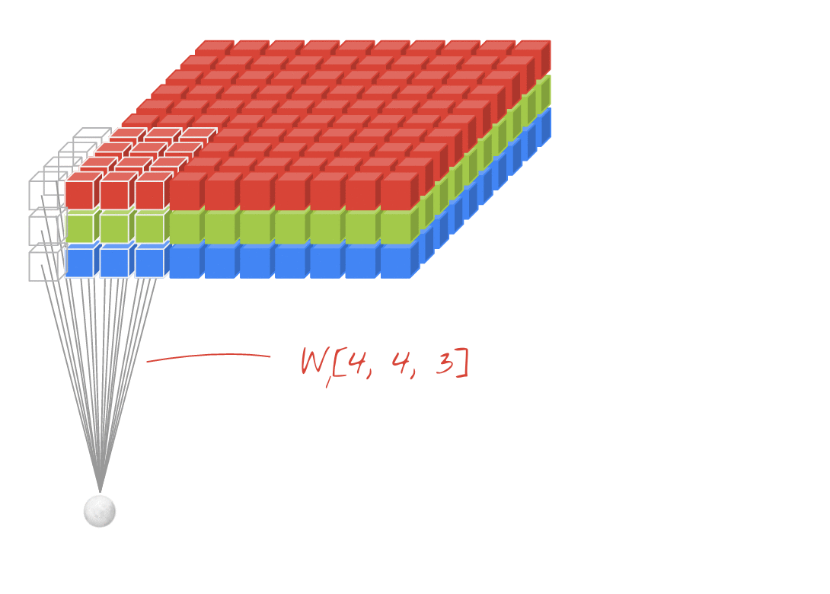
Convolution in 3D
Source

Slide 17
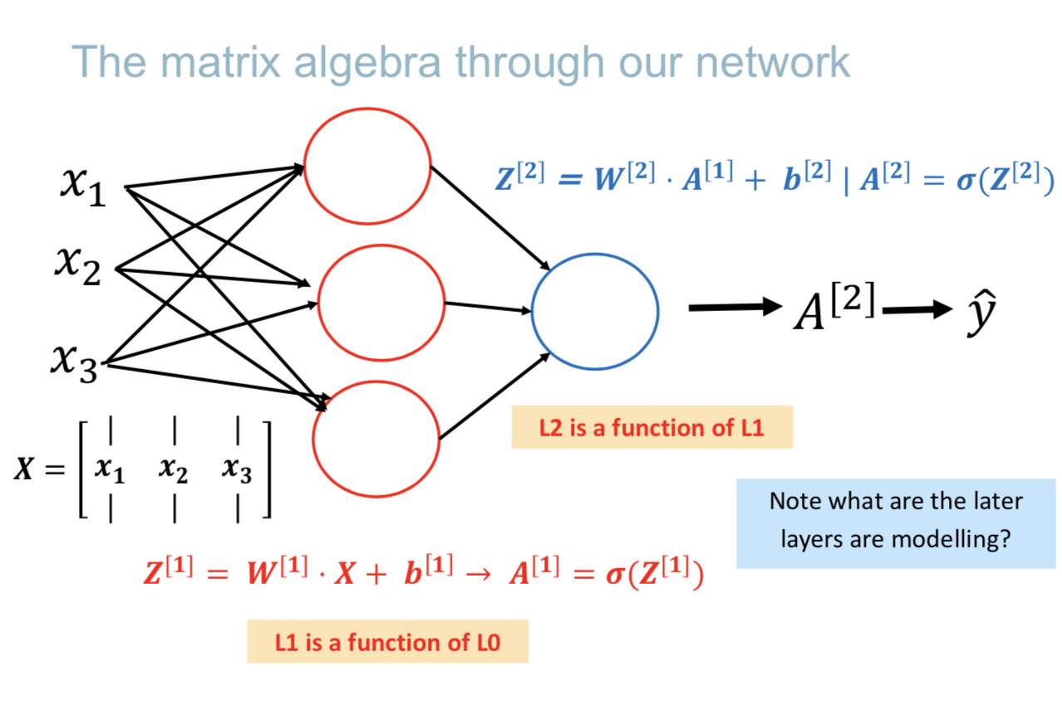
Convolution
The output of this 3-d matrix operation is only 1D, so we can stack as many of these Filters/Kernels as we like
Therefore stacking activation maps.
So we make ‘New Images’ which are fed into the next layer, building higher order features.
This sounds familiar…..

Slide 18
Convolutions & Receptive Fields
You will often here the term ‘Receptive Field’ around CNNS
The filter (3*3 or 5*5) can be considered a ‘Receptive field’ for each Neuron
A neuron in CNNs is a point on the activation map.
Each neuron in the activation map shares the same parameters (same filter)
But each neuron in the same position across activation maps will be looking at the same region in the input but for different things.

Slide 19
Visualising Intermediary LAyers
A lot of work has been done to assist visualising what is going on at intermediary layers.
Since computer vision is ‘visual’, perhaps we can ascribe some human meaning to these layers and features?
The classic paper (link)
For a given feature map, we show the top 9 activations, each projected separately down to pixel space, revealing the different structures that excite that map and showing its invariance to input deformations. Alongside these visualizations we show the corresponding image patches

Slide 20
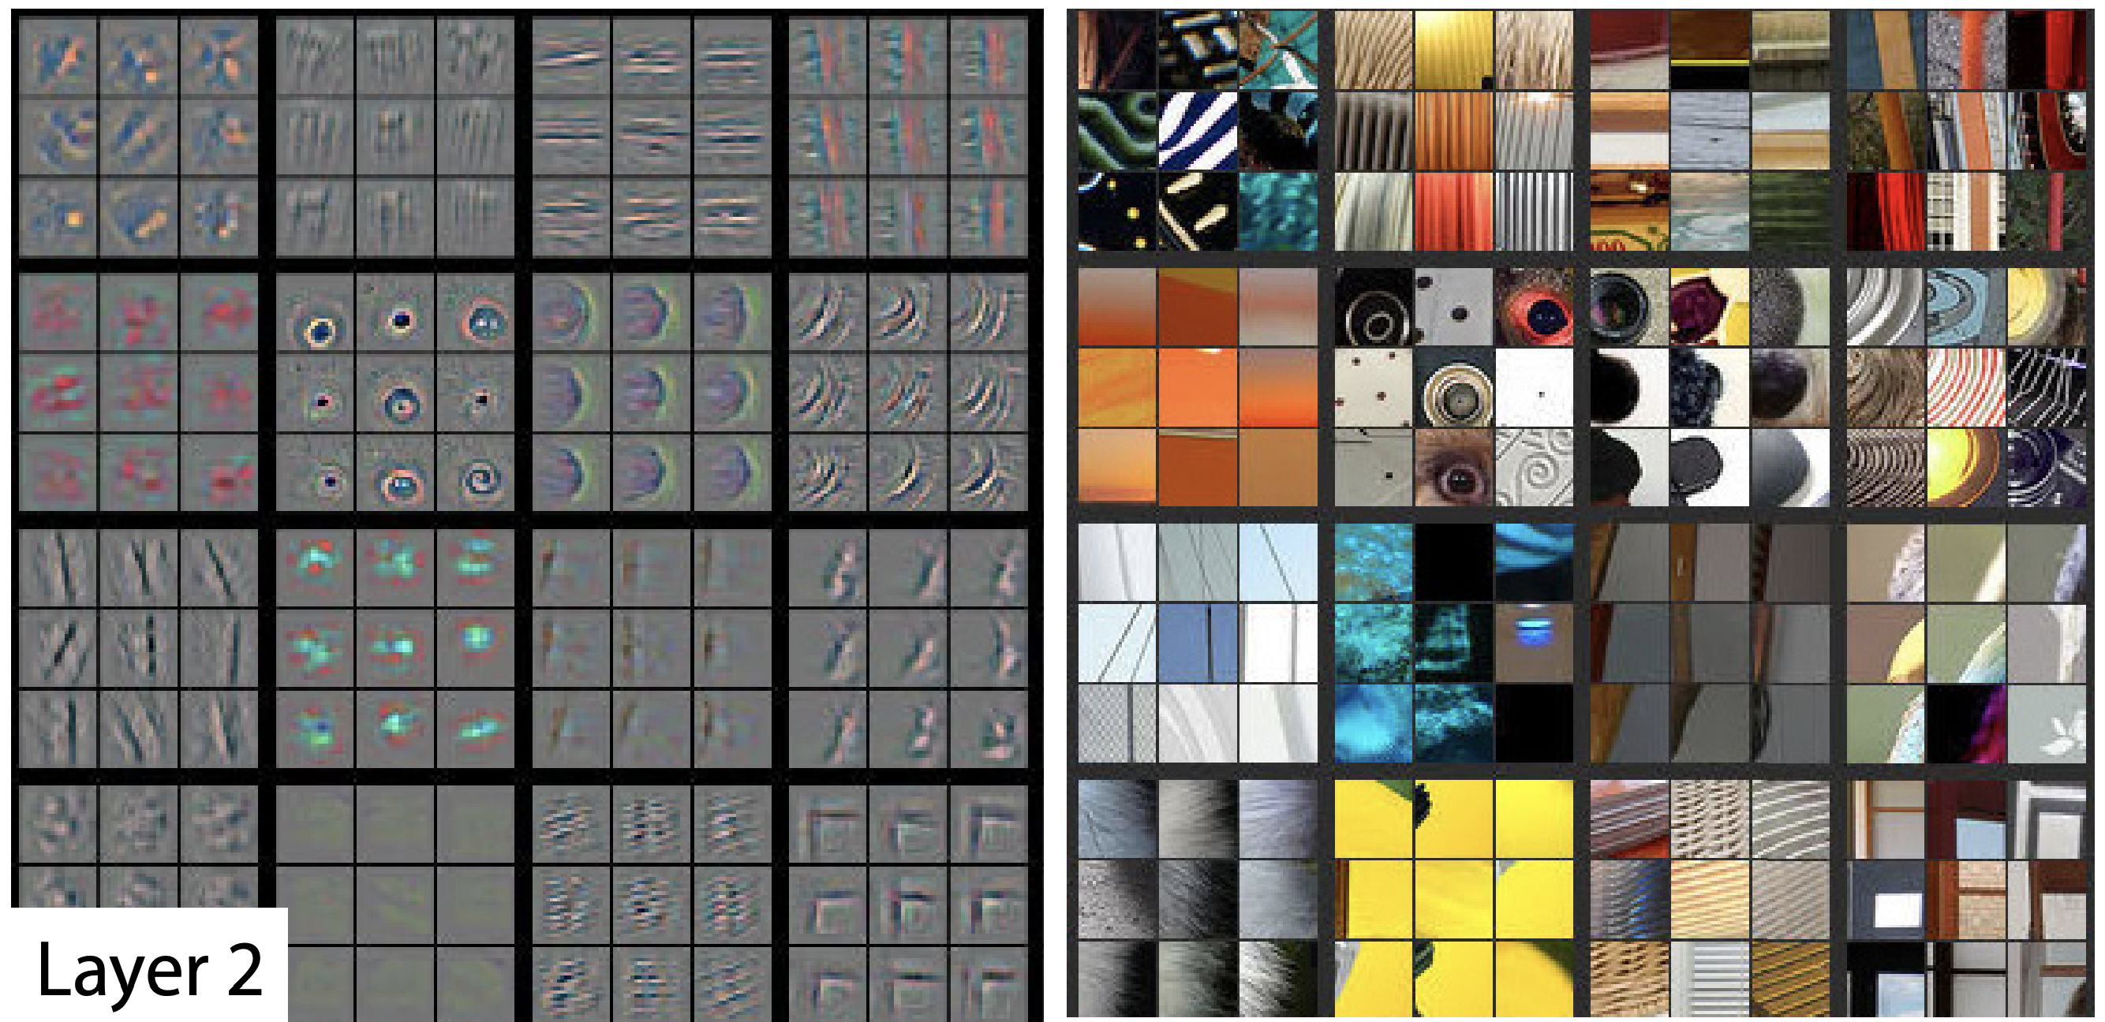
Visualising Intermediary LAyers

Slide 21
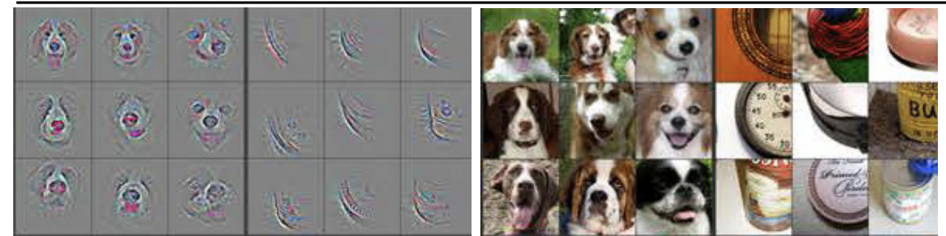
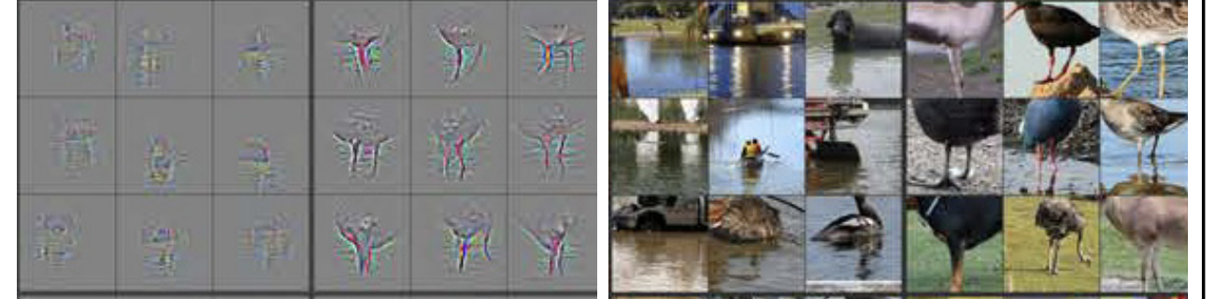
Visualising Intermediary LAyers
Layer 4

Slide 22
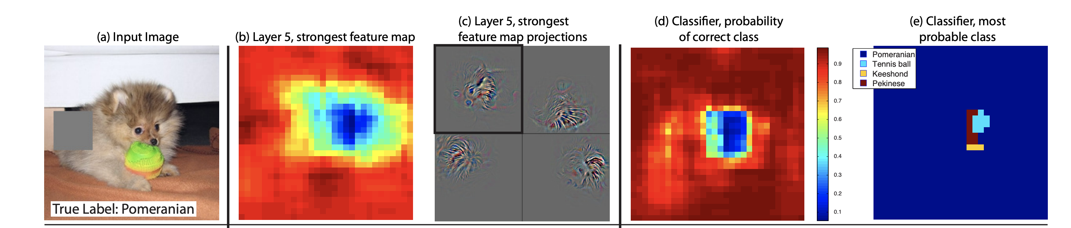
Visualising Intermediary LAyers
Occlusion Sensitivity:
With image classification approaches, a natural question is if the model is truly identifying the location of the object in the image, or just using the surrounding context. Fig. 6 attempts to answer this question by systematically occluding different portions of the input image with a grey square, and monitoring the output of the classifier. The examples clearly show the model is localizing the objects within the scene, as the probability of the correct class drops significantly when the object is occluded.
When the dog’s face is obscured, the probability for “pomeranian” drops significantly. …(e)….but if the dog’s face is obscured but not the ball, then it predicts “tennis ball”

Slide 23
Visualising Intermediary LAyers
Try it yourself ☺
https://towardsdatascience.com/how-to-visualize-convolutional-features-in-40-lines-of-code-70b7d87b0030
https://towardsdatascience.com/understanding-your-convolution-network-with-visualizations-a4883441533b
https://towardsdatascience.com/https-medium-com-rishabh-grg-the-ultimate-nanobook-to-understand-deep-learning-based-image-classifier-33f43fea8327
https://tensorspace.org/index.html
Notes:
Let’s have a play with tensorspace.

Slide 24
Convolution
We saw that the filter/kernel slides along the input. We call this the step size
Typically 1 or 2.
If this won’t fit nicely we use zero padding
This technique also assists us to not lose information at the edges of our image.
The formula to work out our output size is:

Slide 25
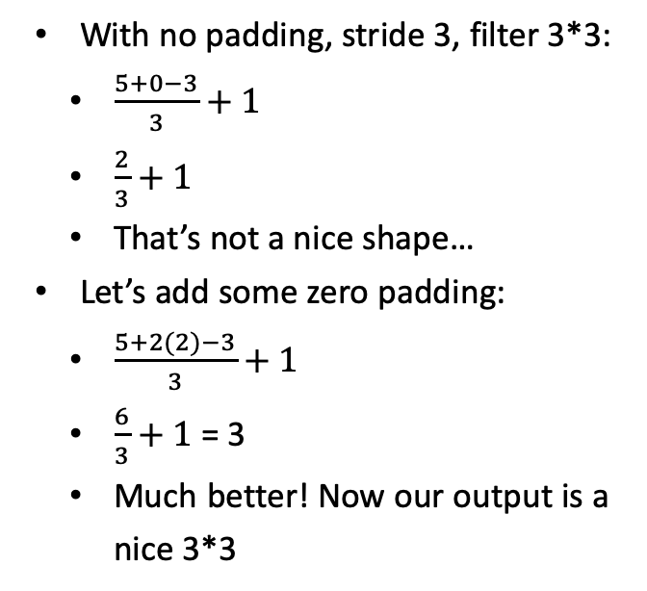
Convolution Example
0
0
0
0
0
0
0
0 | 0 | 0 | 0 | 0 | 0 | 0
0
0
0
0
0
0
0
0 | 0 | 0 | 0 | 0 | 0 | 0
With no padding, stride 3, filter 3*3:
$\frac{5+0−3}{3}+1$
$\frac{2}{3}+1$
That’s not a nice shape…
Let’s add some zero padding:
$\frac{5+2(2)−3}{3}+1$
$\frac{6}{3}+1$ = 3
Much better! Now our output is a nice 3*3
0
0
0
0
0
0
0
0
0
0
0 | 0 | 0 | 0 | 0 | 0 | 0 | 0 | 0
0 | 0 | 0 | 0 | 0 | 0 | 0 | 0 | 0

Slide 26
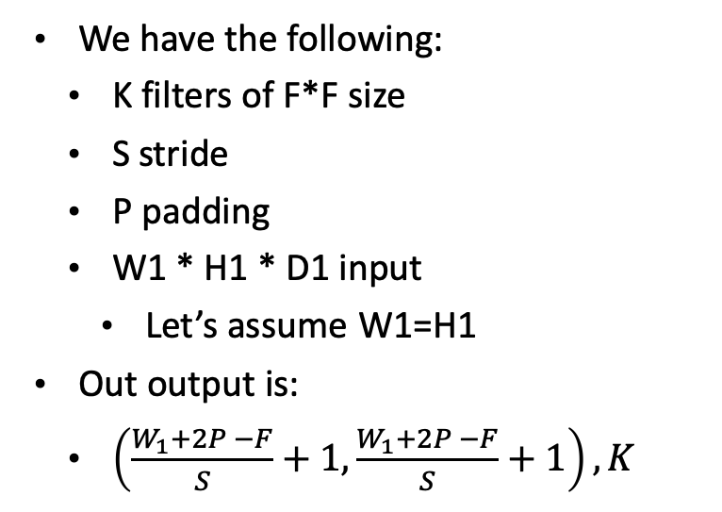
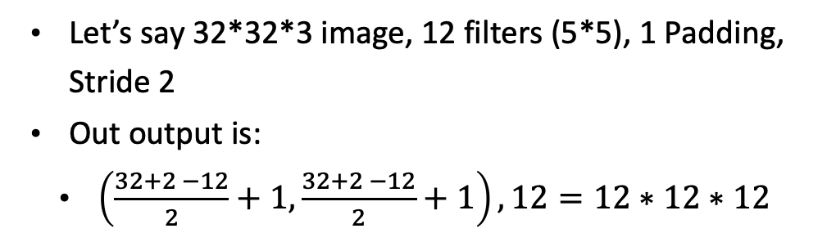
A Summary of the maths:
We have the following:
K filters of F*F size
S stride
P padding
W1 * H1 * D1 input
Let’s assume W1=H1
Out output is:
$\left(\frac{W_{1}+2P −F}{S}+1,\frac{W_{1}+2P −F}{S}+1\right), K$
Let’s say 32*32*3 image, 12 filters (5*5), 1 Padding, Stride 2
Out output is:
$\left(\frac{32+2 −12}{2}+1,\frac{32+2 −12}{2}+1\right), 12=12∗12∗12$

Slide 27
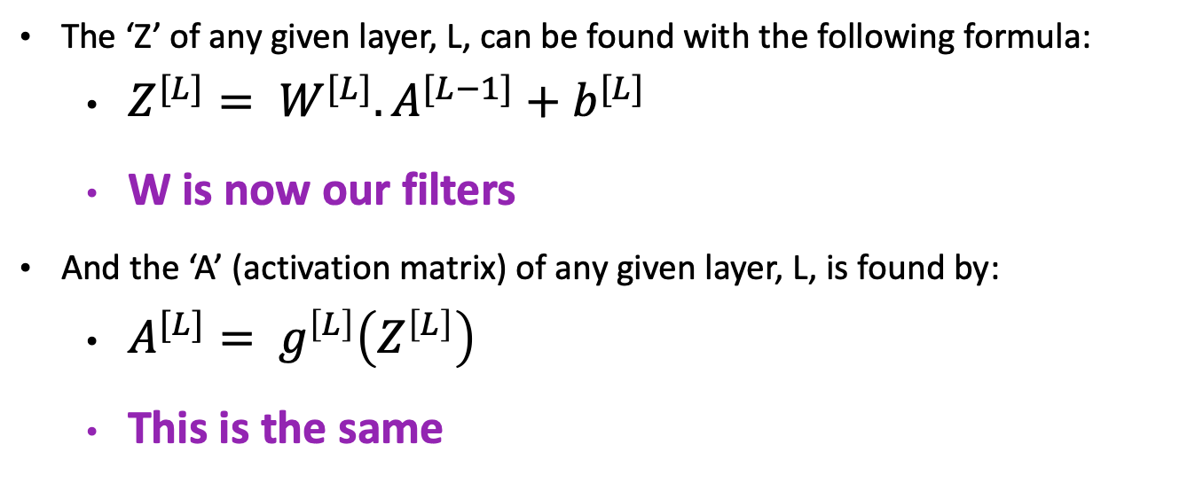
Convolutions & Vanilla NN?
The ‘Z’ of any given layer, L, can be found with the following formula:
$Z^{[L]}= W^{[L]}.A^{[L−1]}+b^{[L]}$
W is now our filters
And the ‘A’ (activation matrix) of any given layer, L, is found by:
$A^{[L]}= g^{\left[L\right]}\left(Z^{\left[L\right]}\right)$
This is the same

Slide 28
Standard Sizes:
Typical Stride Values:
1 or 2 (more often 2) typically.
Larger strides will reduce network (information loss) faster
Typical Kernel/Filter Sizes:
3, 5, 7
Typical numbers of filters:
128, 256, 512…
Different architectures different approaches. VGG doubled each conv layer.

Slide 29
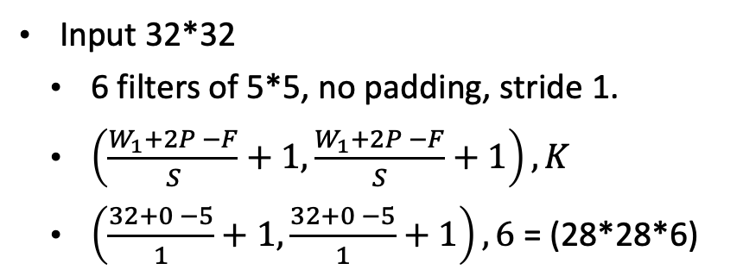
Back to LeNet
Input 32*32
6 filters of 5*5, no padding, stride 1.
$\left(\frac{W_{1}+2P −F}{S}+1,\frac{W_{1}+2P −F}{S}+1\right), K$
$\left(\frac{32+0 −5}{1}+1,\frac{32+0 −5}{1}+1\right), 6$ = (28*28*6)
Fun Fact: Technically there was padding as digits were maximum 20*20

Slide 30
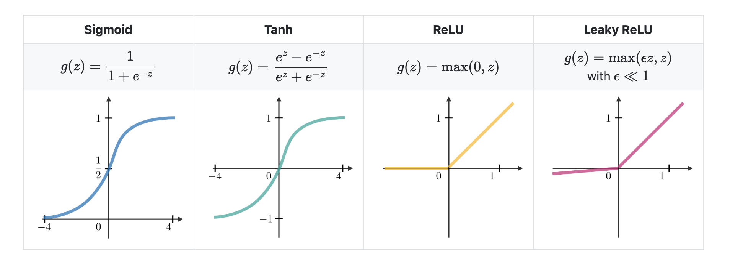
Activations
Follow the convolution layer
Which makes sense considering our Vanilla NN flow
https://stanford.edu/~shervine/teaching/cs-229/cheatsheet-deep-learning

Slide 31
Pooling Layer
This is an operation to reduce the number of parameters (Down Sampling) to reduce parameters and compress representations.
We down sample spatially, not in the depth channel
Max pooling is the most popular method where you take the maximum value in the region.
We must also select a Filter and Stride size for this. (Typically 2/2 or 3/2)

Slide 32
Fully connected (Dense) Layer
Note that Yann LeCun has famously noted there is no such thing as a fully connected layer just
“convolution layers with 1x1 convolution kernels and a full connection table”
In essence, we ‘stretch out’ our matrix to achieve a 1-dimensional vector output. It can be thought of as the ‘classification’ component of our model.
Alexnet = last layer of size 1000
LeNet = last layer of size 10

Slide 33
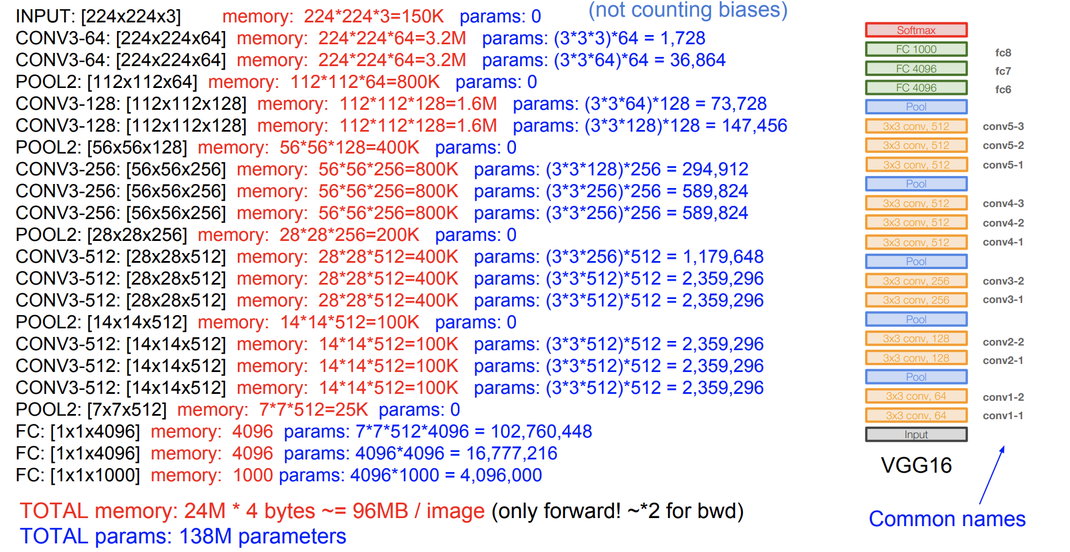
Fully connected (Dense) Layer
It is ‘fully connected’ since each input is present (due to matrix multiplication) in each ‘number’ (neuron) of the output.
You can add more FC layers to enhance the ability to combine complex patterns from your earlier feature maps.
Careful though, FC layers are immensely computationally expensive!
(Source)
138M Parameters
122M are in FC layers

Slide 34
Extra Readings & Sources
https://towardsdatascience.com/https-medium-com-rishabh-grg-the-ultimate-nanobook-to-understand-deep-learning-based-image-classifier-33f43fea8327
https://towardsdatascience.com/gentle-dive-into-math-behind-convolutional-neural-networks-79a07dd44cf9
https://pythonmachinelearning.pro/introduction-to-convolutional-neural-networks-for-vision-tasks/

Slide 35
Regularisation for CNN
What we already know:
L2 still used
Dropout more common in fully connected
Some people don’t like it at all (here)
Keras ref (here)
A few new ones:
Maxnorm
Batch Normalisation
Data Augmentation

Slide 36
Max Norm
From Keras Documentation (link):
Constrains the weights incident to each hidden unit to have a norm less than or equal to a desired value.
Essentially creating an upper bound for the magnitude of the weight vector for every neuron.
A nice tutorial in Keras adding this and other constraints (link)

Slide 37
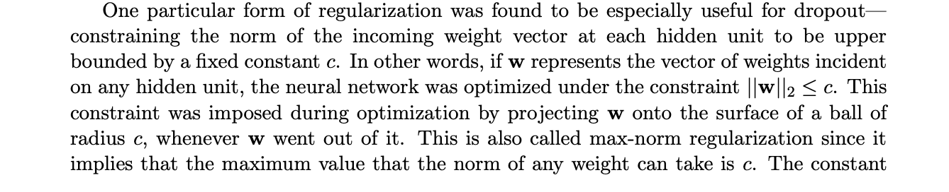
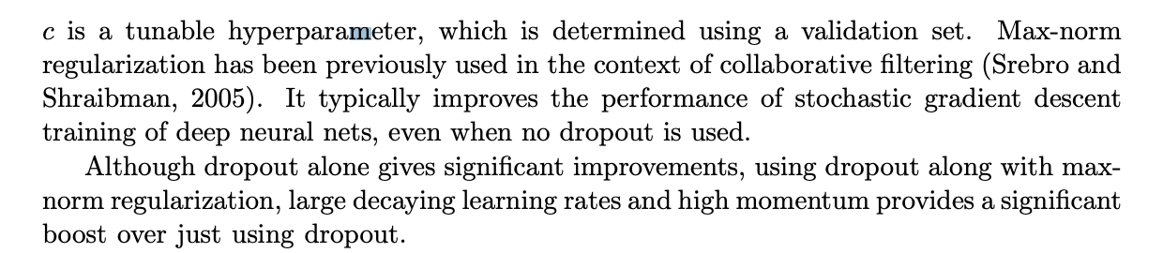
Max Norm
From the dropout paper (link):

Slide 38
Batch Normalisation
(Source) Loffe & Szegedy, 2015
Essentially force a unit-gaussian distribution on the inputs at each layer (for each neuron).
Usually inserted after FC/Conv layers (before activation)
Nice Article (here)
Our process:
Calculate minibatch mean (subtract from output)
Divide by SD of the minibatch
We actually have some hyperparameters Scaling (Gamma) and Shift (beta) to allow layers to determine how much unit-gaussian-ness is necessary

Slide 39
Batch Normalisation
Why? Some advantages:
Improves gradient flow
Alleviates issues with bad initialisation
Allows larger learning rates to be used
Effectively regularises
Why? See answer by Ian Goodfellow here
In Keras?
Simply add as another layer. A nice stackoverflow answer here
The Keras documentation page (here)
A nice walkthrough example (here)

Slide 40
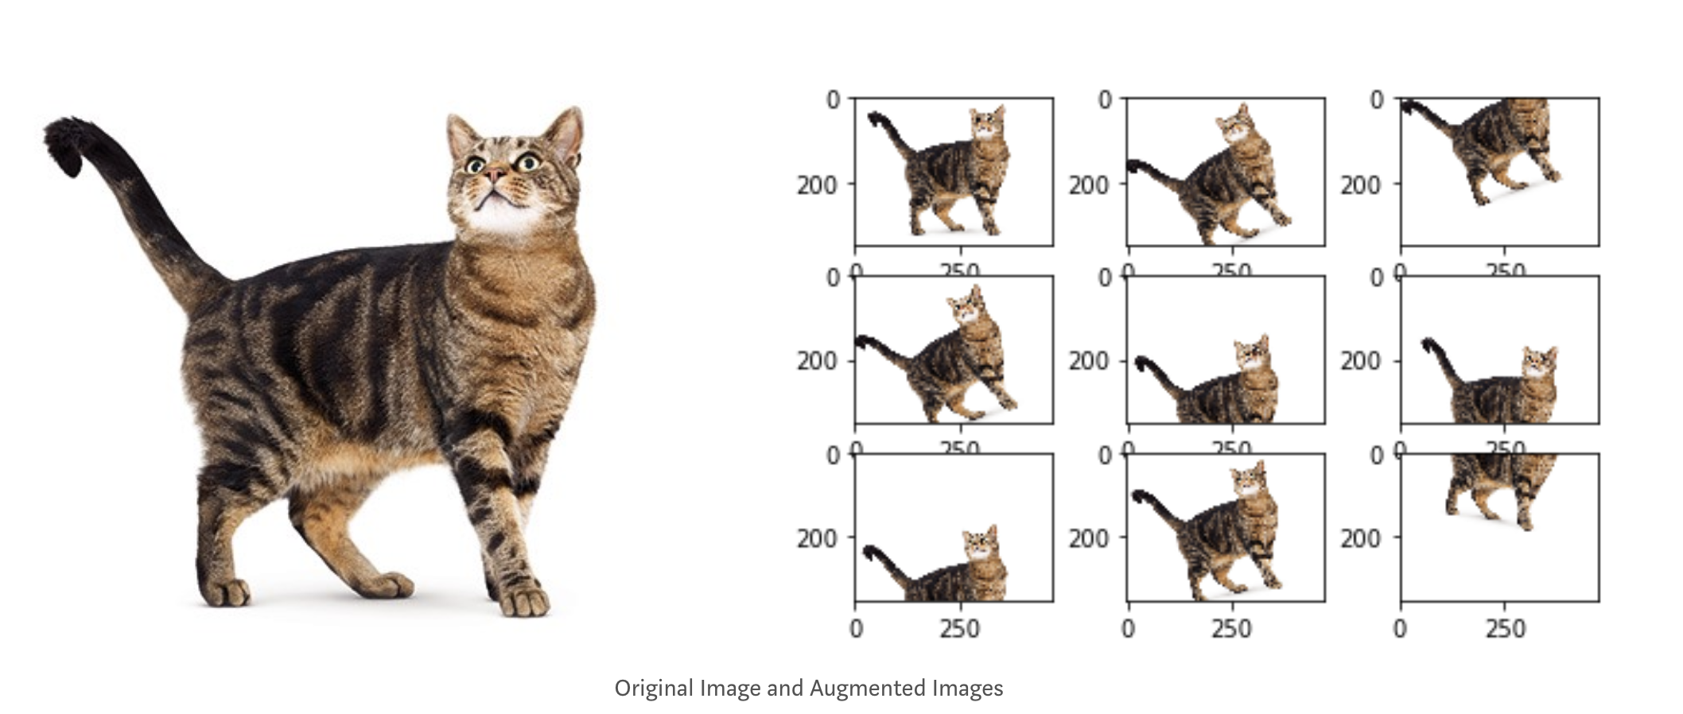
Data Augmentation
Chop, change, flip, crop your images
Produces more data (Deep learning loves more data)
Helps with image difficulties (occlusion, variation etc)
Keras provides a nice ImageDataGenerator class to assist
Source

Slide 41
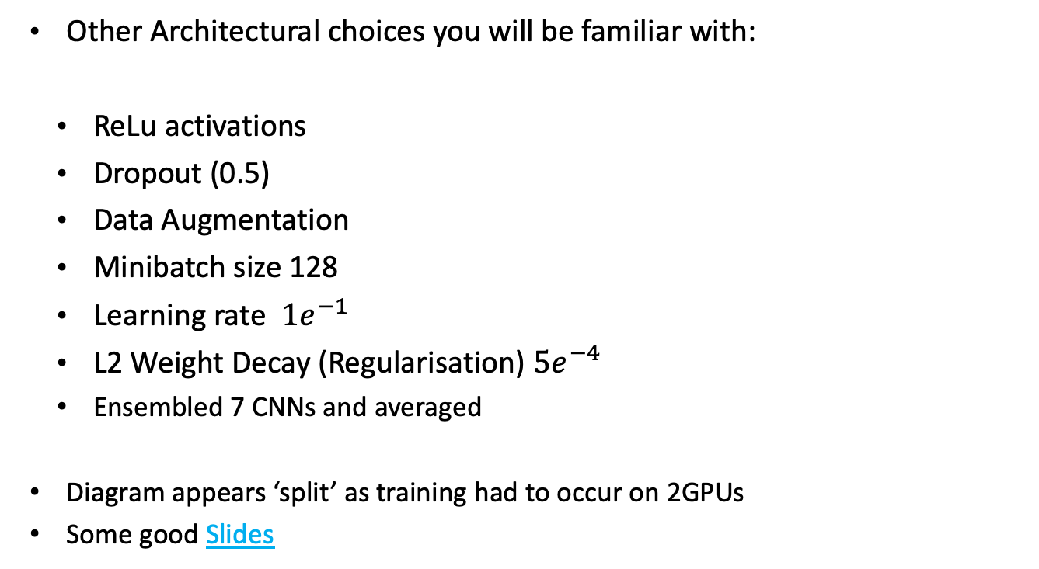
Back to AlexNet
CONV1
Max Pool1
NORM1
CONV2
Max Pool2
NORM2
CONV3
CONV4
CONV5
Max Pool3
FC6
FC7
FC8
Other Architectural choices you will be familiar with:
ReLu activations
Dropout (0.5)
Data Augmentation
Minibatch size 128
Learning rate $1e^{−1}$
L2 Weight Decay (Regularisation) $5e^{−4}$
Ensembled 7 CNNs and averaged
Diagram appears ‘split’ as training had to occur on 2GPUs
Some good Slides

Slide 42
VGGNet (16 and 19)
VGG:
(Source) From the Visual Geometry Group at Oxford.
Some notable features:
Had more layers (19) but smaller filters (3*3 rather than 7*7 or larger) than AlexNet
Before batch normalisation so difficult to train network this size (trained for weeks)
(Source)

Slide 43
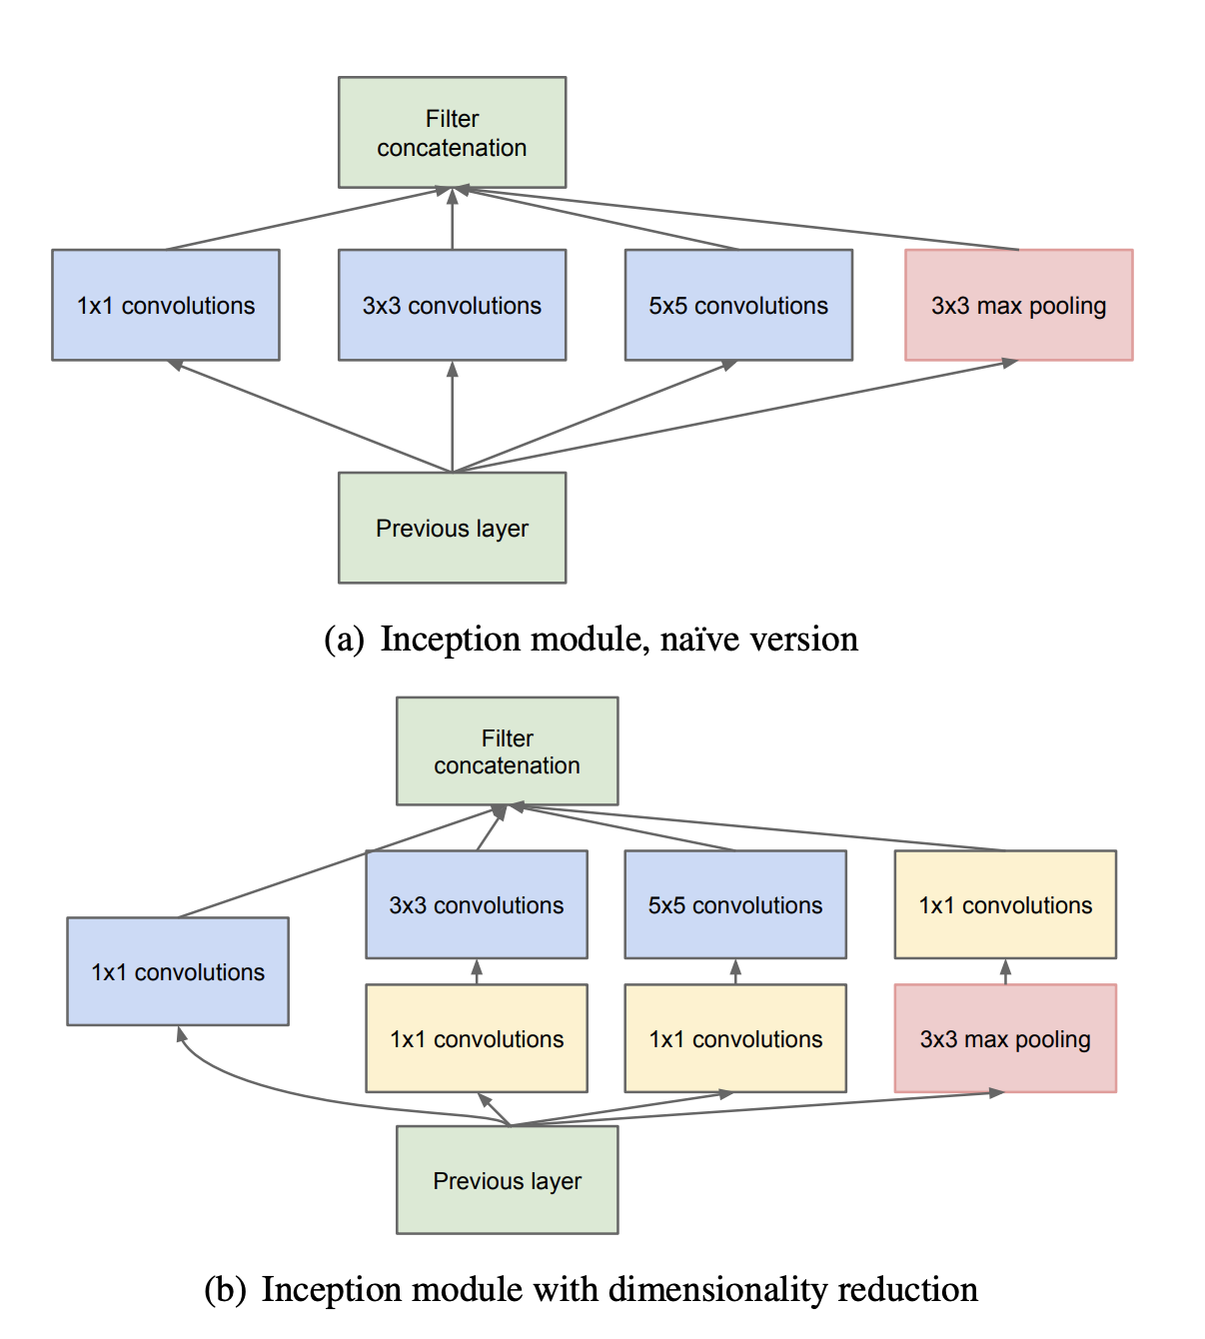
GoogleNet (‘Inception’)
(Source) From….Google
Also 19 layers but some more computational efficiency. (More in later versions)
Introduced the ‘Inception Module’
Work on getting good local structure using ‘a network within a network’
In practice:
Apply several convolutions with different receptive field sizes in parallel and concatenate depth-wise (using some padding to help)

Slide 44
GoogleNet (‘Inception’)
Problem:
Huge computational complexity
Solution:
Use 1*1 convolutions to bottleneck the layers.
(Layer-to-1*1 plus 1*1 to 5*5) is cheaper than direct layer-to-5*5

Slide 45
Back to this….
Classification (Softmax) layer
‘Vanilla’ CNN
Auxilliary classification outputs
Inception Modules
A mini-network (softmax and all) to inject gradient into initial layers of the network. Due to lack of batch-norm, this was used to ensure deeper networks would work.
Notes:
GoogLeNet

Slide 46
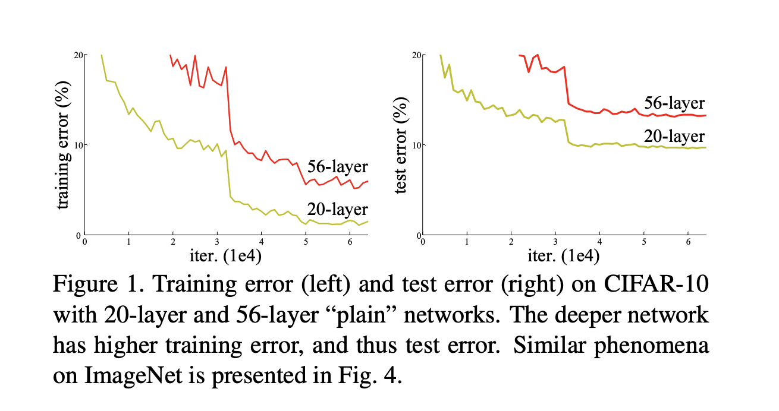
ResNet & ResNExt
(Source) From Microsoft
Recall: Alexnet was 7, VGG/Google was 19-22 layers.
Vanishing gradient is stalling progress.

Slide 47
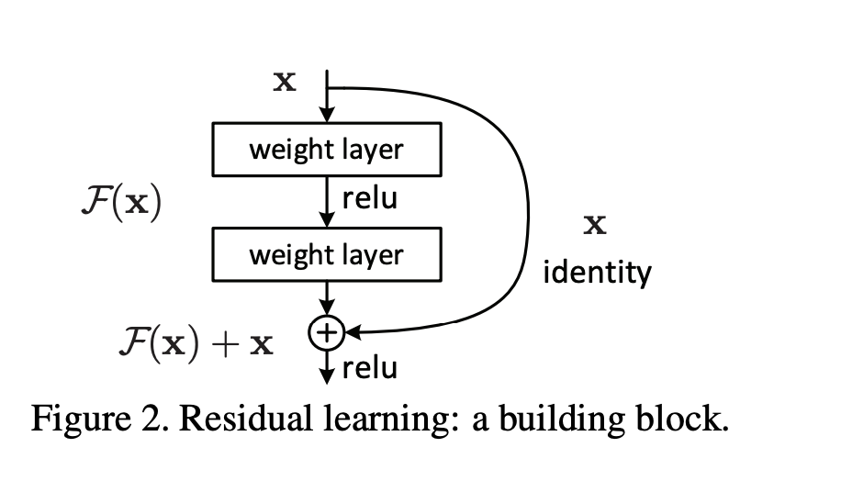
ResNeT
ResNet (Deep residual learning network) was 156 layers – how??
Introducing the residual learning block
In essence it allows for a ‘skip connection’ around layers of the network (that have the same size).
A deeper network shouldn’t produce higher error than a shallower unless it is being forced to learn things it doesn’t want to.
So the network can decide not to use layers
Assists gradient flow (‘Gradient Highways’ - Source)
Notes:
It did also get to use batch norm.

Slide 48
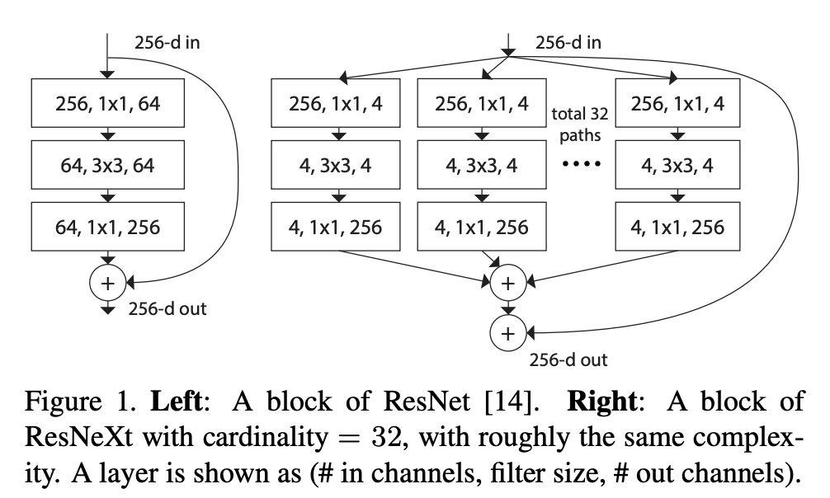
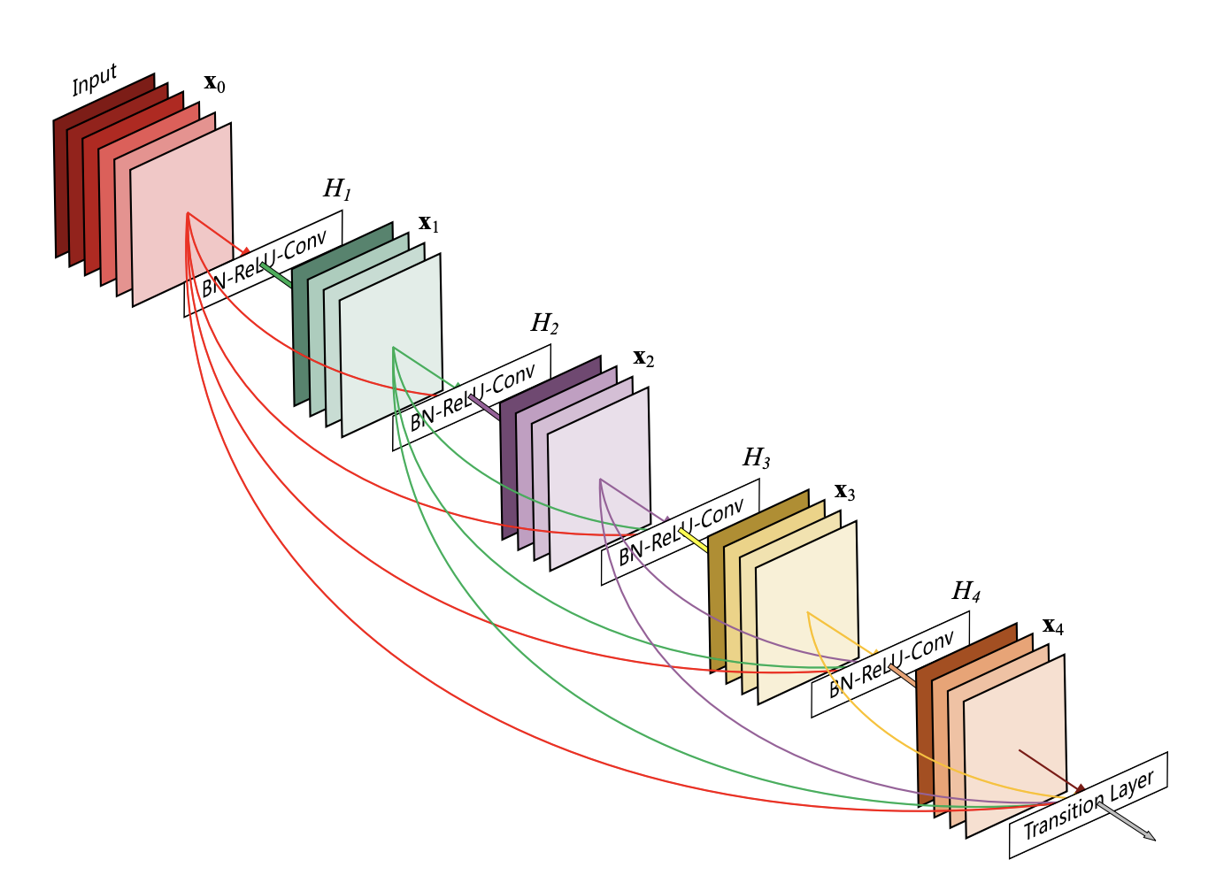
ResNExt & Densenet
Nice blog (here)
ResNext (source) took inspiration from Inception (split-transform-merge) and ResNet together.
Defined ‘cardinality’ which is the number of different paths offered to the network.
Densenet (Source) kind of goes all out in terms of connections between layers
Notes:
It did also get to use batch norm.

Slide 49
Other Computer Vision Tasks
http://cs231n.stanford.edu/slides/2017/cs231n_2017_lecture11.pdf

Slide 50
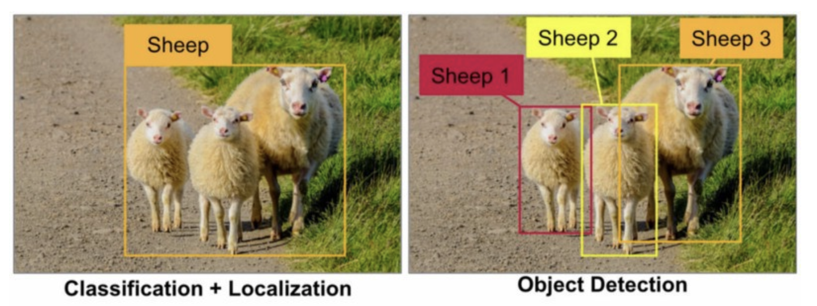
Bounding Boxes (Localisation)
Here we not only care about what is in the image but we care about where it is in the image.
What would be our objective function for this?
Source
We have two objective functions:
A softmax (detection)
Four geographical points for the box corners (Localisation)
(X, Y, W, H) [Regression Loss]

Slide 51
Intersection over Union
A common metric to determine how close your bounding boxes are to the exact ones is Intersection of Union (IOU)
We will rarely get an exact match of bounding boxes, so this metric helps approximate our boxes.
Over 0.5 is pretty good.
A nice tutorial here

Slide 52
How do we determine where to put boxes?
Historically there was a proposed ‘sliding window’ approach where you slide many windows of different sizes over the image, each feeding through a CNN.
There was great work done between 2013 and 2015/16 on region-based methods. (A nice youtube video here)
R-CNN (Source, 2014).
Generate 2000 ‘Region Proposals’ (based on ‘selective search’), warp and feed each into CNN to get features and classification (including ‘background’ as category).

Slide 53
How do we determine where to put boxes?
Fast R-CNN (Source, 2015)
Takes the region proposals from last feature map of convnet, sharing processing, 9x faster than R-CNN in training, hundreds of times faster in testing, better performance, combines losses.
Fast-er R-CNN (Source, 2016)
The bottleneck with Fast R-CNN was the region proposal generation
Therefore has ‘Region Proposal Network’ that predicts proposals from features, has its own loss

Slide 54
SSD & Yolo (Real Time Bounding Boxes)
SSD (Source, 2015-16) and Yolo (Source, 2015-16)
Yolo has released YoloV2, Yolo9000 (‘Better, Faster Stronger’)
Slides on Yolo9000 and author website papers
Latest version is YoloV3 (‘An incremental Improvement)
Nice Explanation (here) and (here)
More on v3 here
A paper and blog on the trade off between these networks.
Stanford slideshow on the different networks (here)

Slide 55
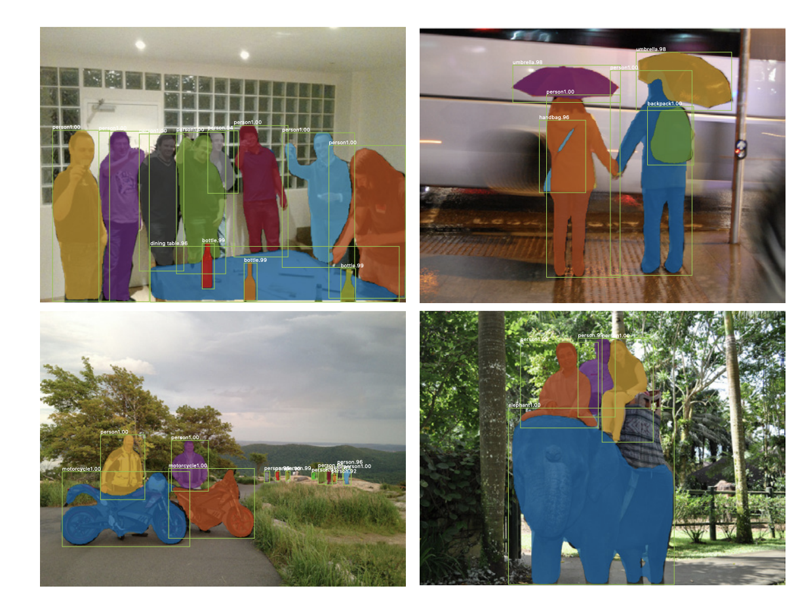
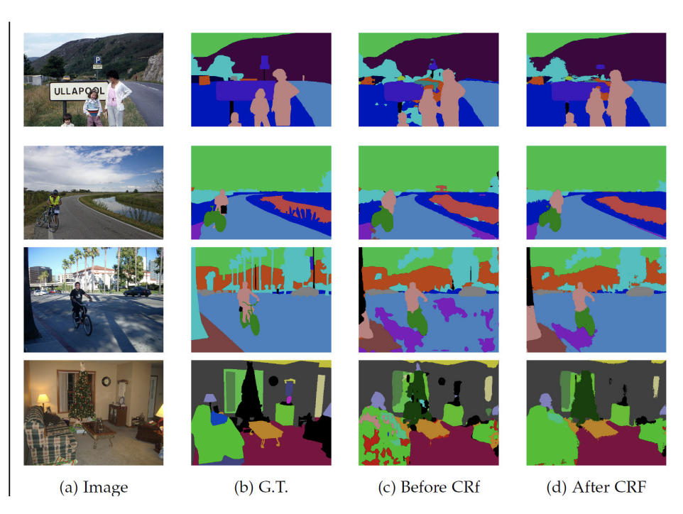
Semantic/Instance Segmentation
The state of the art for a while has been Mask R-CNN (Source)
There is also
U-Net (source) and in Keras (here)
DeepMask (Facebook) (Here)
Deeplab (google) (here / here)

Slide 56
Which architecture?
A good paper (here)and (blog) compares computational power vs efficiency for a number of classic models.
This is accuracy per million parameters

Slide 57
Why start from scratch?
We know that some CNN architectures are great at extracting features (to the level of being able to classify objects) from images.
We can think of CNNs as feature extractors or data transformers.
So can’t we leverage some of the hard work already done with large training sets?
This is the idea behind transfer learning
Train a neural network on a large dataset
Reinitialise and train (or add) the last FC layer
Perhaps multiple FC layers if you have the time/resources
Perhaps ‘unfreeze’ more layers with time/resources

Slide 58
Lab – Computer Vision in Keras

